Slide 1
UNCERTAINTY QUANTIFICATION OF AGENT-BASED MODELS WITH APPLICATION TO MALARIA INTERVENTION MODELING
PhD Update
January 2025

Slide 2
Aim
To quantify and propagate the uncertainty from various parameters in the OpenMalaria Ghana model, beyond just the entomological inoculation rate (EIR) and to determine the impact of these uncertainties on simulating the effect of malaria interventions at the sub-national level.

Slide 3
Uncertainty Quantification can be classified in two forms
The field of Uncertainty Quantification offers a means of quantifying and characterizing uncertainties in models and the real world.
Forward Propagation of Uncertainty
Investigates the impacts of random input values of model parameters on model outputs
Inverse Uncertainty Quantification
using experimental data to learn about the sources of modeling uncertainty
Sensitivity Analysis
Model Calibration

Slide 4
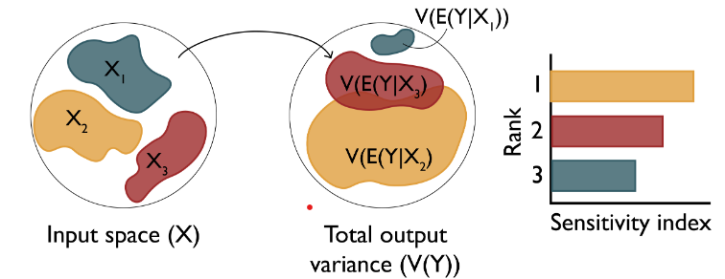
Research Objectives
Objective 1: Understand the key drivers of impact of malaria interventions in Ghana
Objective 3: Simulate the impact of malaria interventions in Ghana in order to support decisions for strategic planning
Objective 2: Develop a novel inference framework for calibrating the OpenMalaria model at a higher spatial resolution
Perform sensitivity analysis of coverage, halflife of efficacy and vector composition towards prevalence reduction and clinical cases averted (Forward Propagation of uncertainty)
Source: Sensitivity Analysis: The Basics

Slide 5
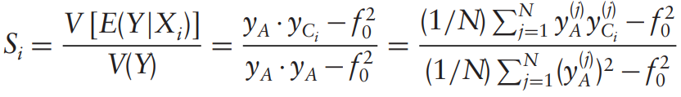
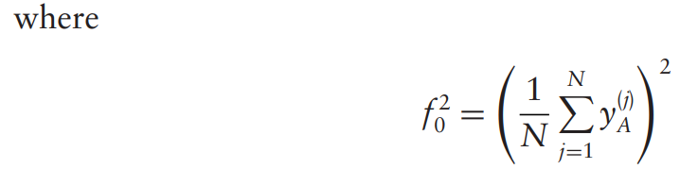
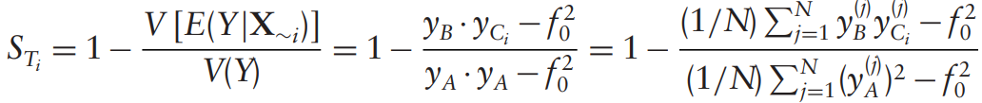
Variance-based sensitivity analysis (Sobol)

Slide 6
Objective 1 – Modifying the existing workflow
Chose a sampling scheme to reduce number of OM simulations and runtime
How do we reduce the number of OM simulations in order to drastically reduce runtime?
Tried other sampling designs instead of sweeps
Trained GP model on prevalence reduction and used model for prediction while performing sensitivity analysis
Choose a sensitivity method (compared soboljansen and sobolsalt)
Notes:
To address uncertainties, we identify and quantify the various sources of uncertainty in intervention modeling

Slide 7
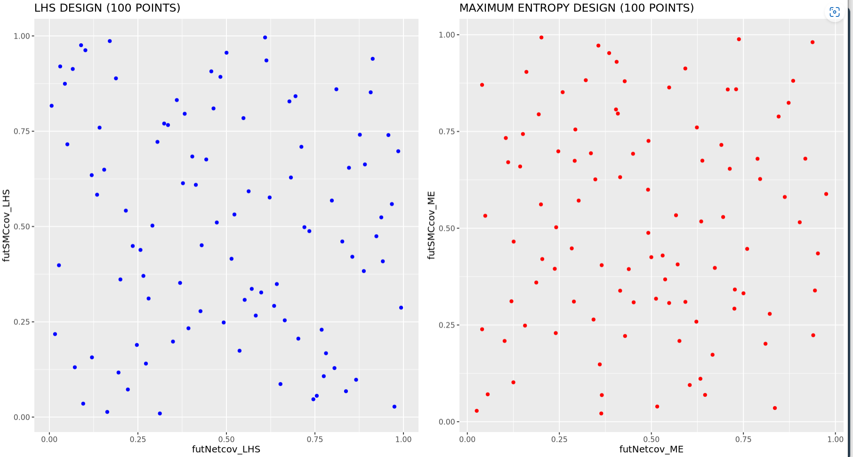
1 – LHS vs MED SAMPLING (100 POINTS)
LHS or ME sampling during simulation setup cuts runtime drastically

Slide 8
1 – LHS or ME sampling during simulation setup cuts runtime drastically
SETTING | NUMBER OF SIMULATIONS REQUIRED (SWEEPS) | NUMBER OF SIMULATIONS REQUIRED (LHS) | R-SQUARED | NUMBER OF X_COLS | GP TRAINING TIME (mins)
UPPER.EAST4 | 50K (submitted) | 1500 | 0.97 (sweep) | 4 | 11.9
OTI | 300000 (not submitted) | 2500 | 0.96 (LHS) | 4 | 1.9
BONO.EAST (no_LSM) | 212500 (not submitted) | 2000 | 0.95 (LHS) | 4 | 1.4
Notes:
LLINs is the most influential in determining the output variance

Slide 9
2 – GP performance evaluation - learning of prevalence reduction gives good statistical correspondence Actual vs predict for 3 settings: full EIR sweep for UE and LHS for Oti and BE
The GP was trained using all simulation data
Model performance was evaluated using R-sqaured
Notes:
LLINs is the most influential in determining the output variance

Slide 10
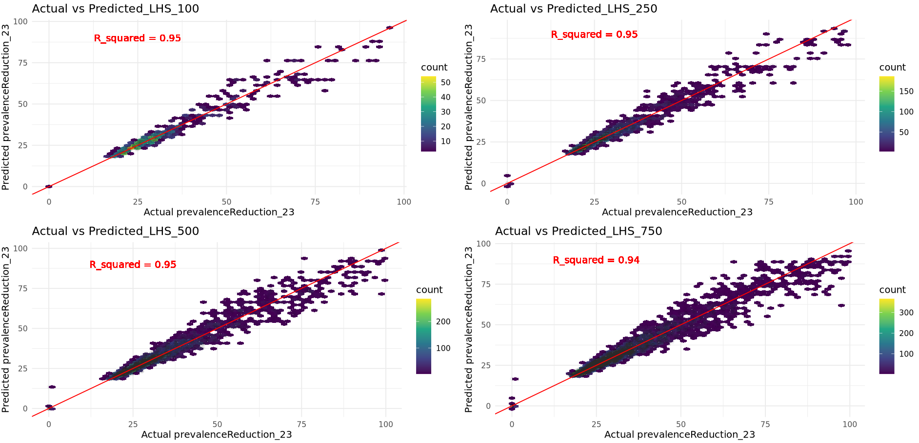
2 – GP performance evaluation - learning of prevalence reduction gives good statistical correspondence Actual vs predict using different LHS sample sizes for UE4
The GP was trained using all simulation data
Model performance was evaluated using R-sqaured
Notes:
LLINs is the most influential in determining the output variance

Slide 11
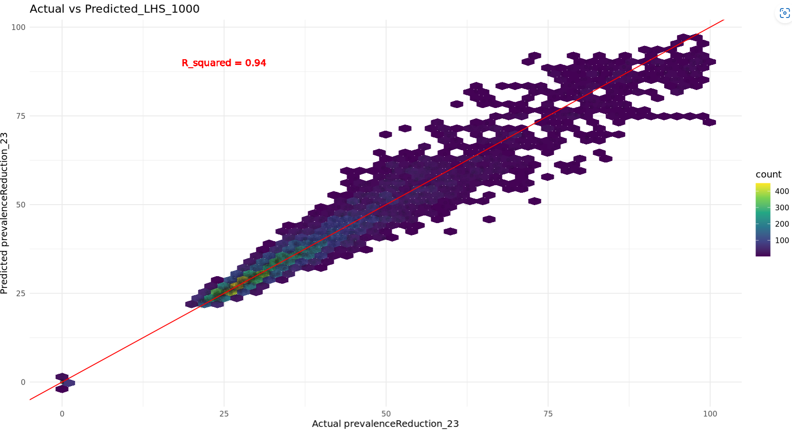
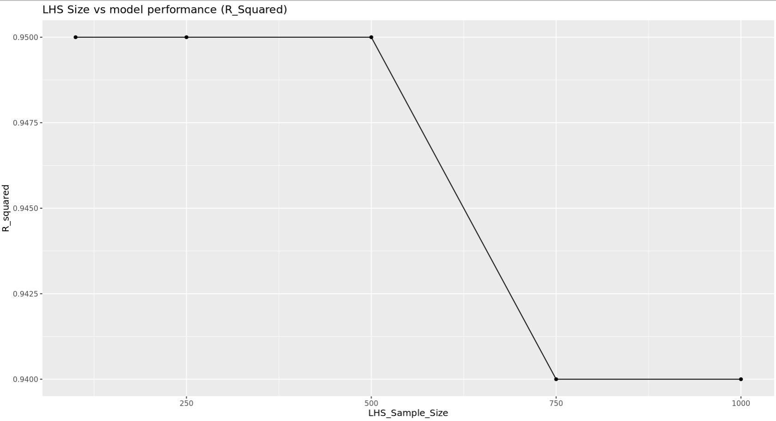
2 – GP performance evaluation - learning of prevalence reduction gives good statistical correspondence Actual vs predict using different LHS sample sizes for UE4
Notes:
LLINs is the most influential in determining the output variance

Slide 12
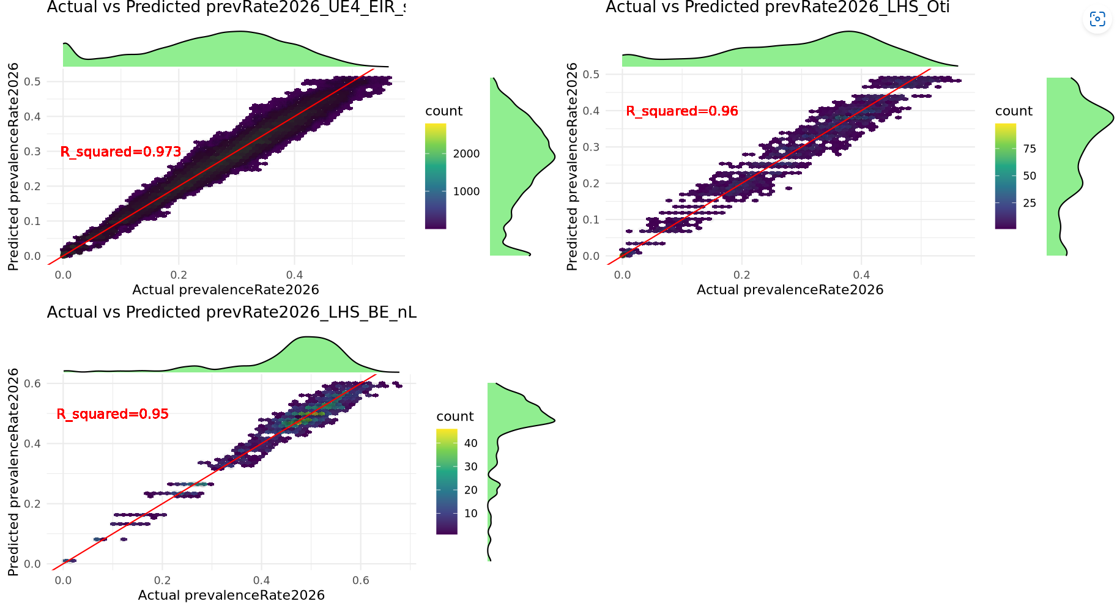
2 – GP performance evaluation - learning of prevalence reduction gives good statistical correspondence Actual vs predict for 3 settings: full EIR sweep for UE and LHS for Oti and BE – Training the Gp with all simulation data
Notes:
LLINs is the most influential in determining the output variance

Slide 13
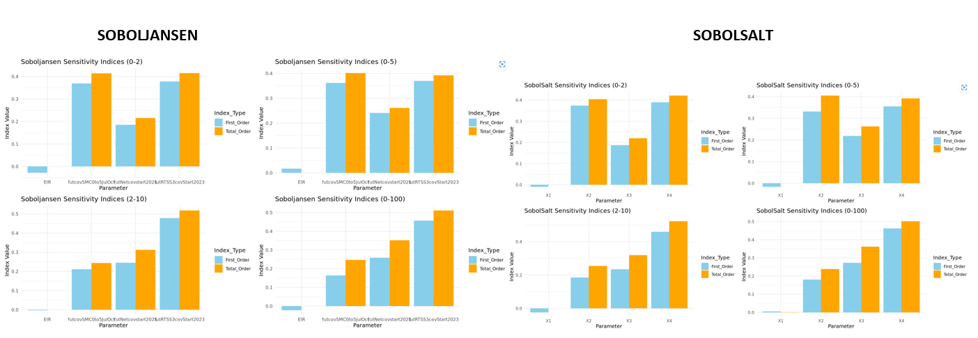
3 - Sobol methods comparison
Sobol sensitivity analysis of future coverages of malaria interventions for 3 settings in ghana: upper.EAST4, OTI and BONO.East.
Notes:
LLINs is the most influential in determining the output variance

Slide 14
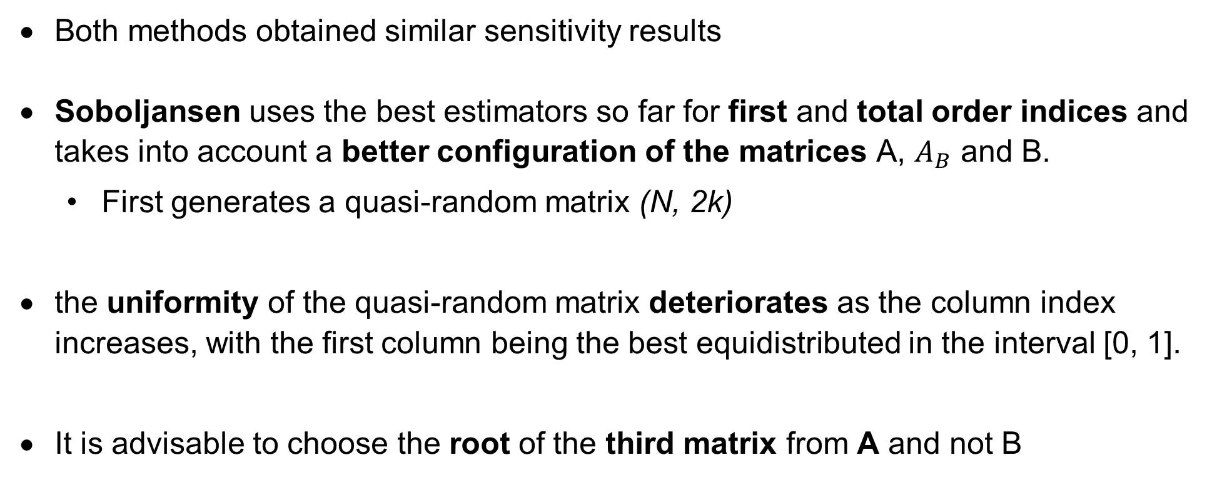
3 - Sobol methods comparison
Both methods obtained similar sensitivity results
Soboljansen uses the best estimators so far for first and total order indices and takes into account a better configuration of the matrices A, $A_{B}$ and B.
First generates a quasi-random matrix (N, 2k)
the uniformity of the quasi-random matrix deteriorates as the column index increases, with the first column being the best equidistributed in the interval [0, 1].
It is advisable to choose the root of the third matrix from A and not B
Model performance was evaluated using R-sqaured
Notes:
LLINs is the most influential in determining the output variance

Slide 15
3 - Sobol sensitivity analysis with setting-specific EIR and realistic intervention coverage ranges
A GP model is trained for each setting using 2-10 age_group, EIR range (2-250) + deployed intervention coverage ranges
Sobol uses setting-specific eir + realistic intervention coverage ranges of interventions to be deployed
Non-deployed interventions are indicated as NA on the plot
Parameter ranges:
futcovSMC0to5JulOct_min = 0.4, futcovSMC0to5JulOct_max = 0.9,
futRTSS3covStart2023_min = 0.5, futRTSS3covStart2023_max = 0.9,
futNetcovstart2021_min = 0.2, futNetcovstart2021_max = 0.8
Hierarchical clustering – agglomerative (bottom-up)
Each setting is treated as data point
We look for how similar or different settings are using the least distance between them
The Distance measure can either be euclidean, squared euclidean, manhattan or cosine
Notes:
LLINs is the most influential in determining the output variance

Slide 16
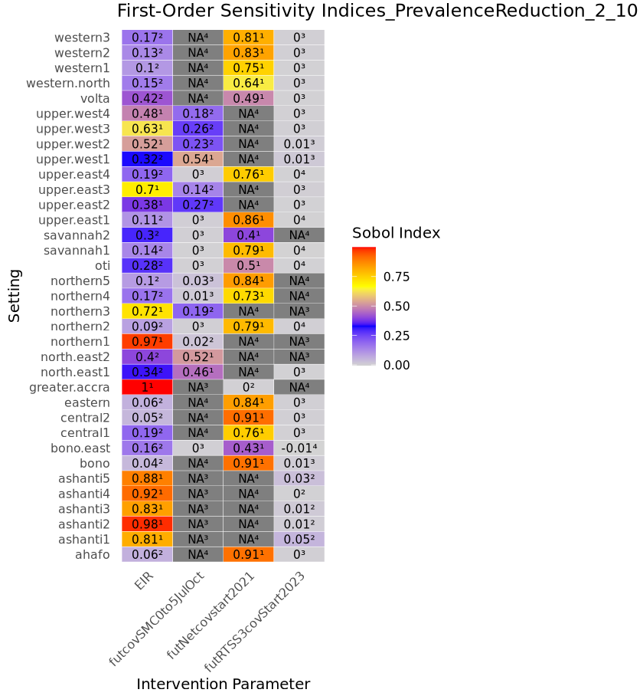
Sobol indices for 35 settings after integrating the above findings in the existing workflow
Sobol sensitivity results show the first order indices of intervention coverage which allows to rank for each setting which intervention is most sensitive to perturbation regarding the impact on prevalence reduction (by 2026).
In terms of prioritization, this work it gives us an idea of what interventions to keep and whether coverage should be high or not
We need to include vaccines for some settings
Policy question: where should we put our efforts? Is prev reduction more prone to loose impact if we maintain coverages of LLIN or SMC?
Get more realistic ranges for RTSS and others
Net2021 was the last campaign
Notes:
LLINs is the most influential in determining the output variance

Slide 17
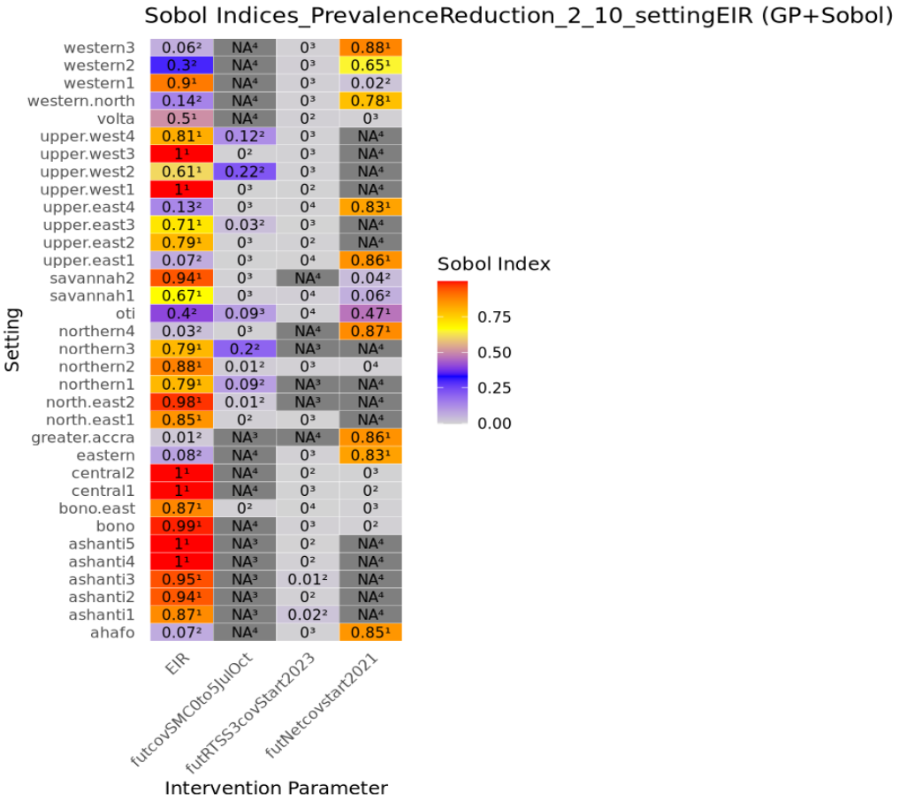
Sobol indices for 35 settings after integrating the above findings in the existing workflow
Notes:
LLINs is the most influential in determining the output variance

Slide 18
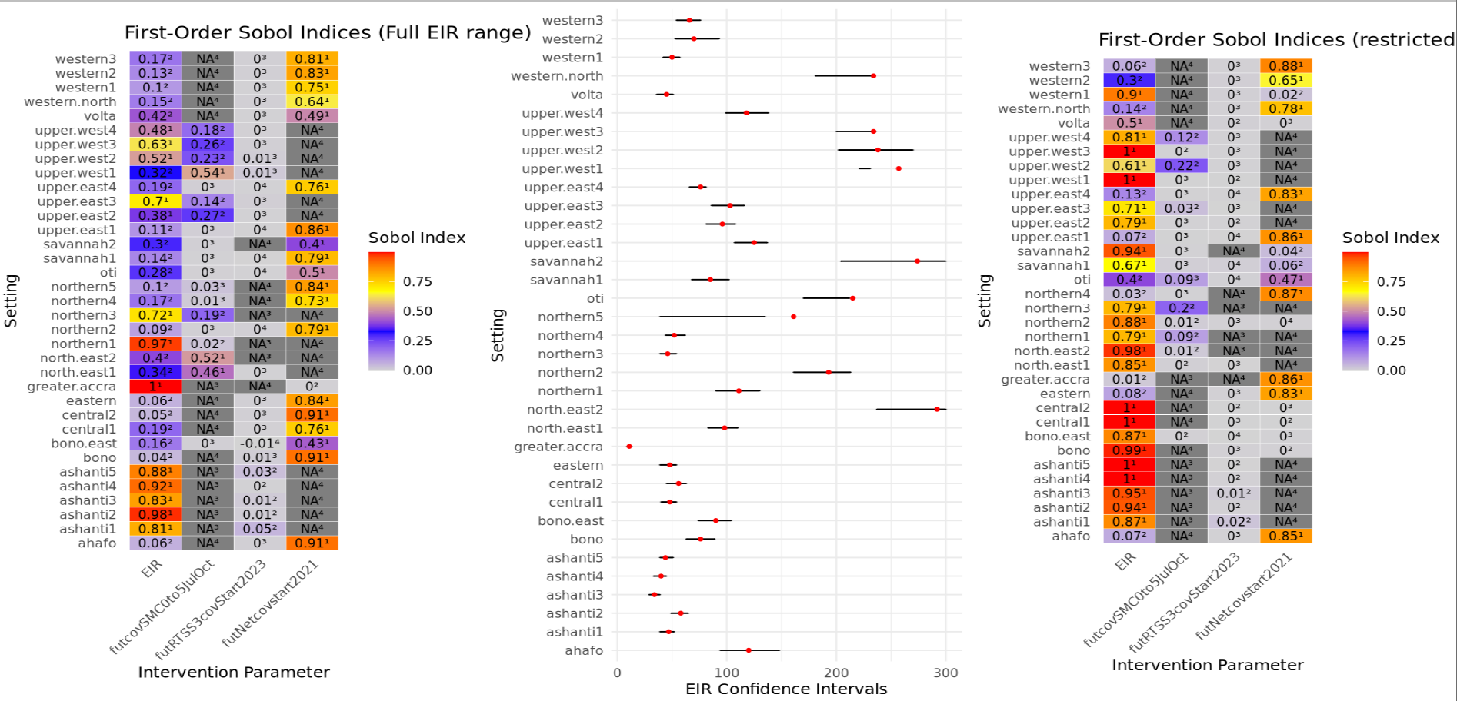
Sobol indices for 35 settings after integrating the above findings in the existing workflow
Notes:
LLINs is the most influential in determining the output variance

Slide 19
Sobol indices for 35 settings after integrating the above findings in the existing workflow – Meeting Discussion
In terms of prioritization, this work gives us an idea of what interventions to keep and whether coverage should be high or not
Using setting specific EIR ranges indicates whether a setting is either a high or low transmission setting
We need to include vaccines for some settings
Policy question: where should we put our efforts? Is prev reduction more prone to loose impact if we maintain coverages of LLIN or SMC?
Get more realistic ranges for RTSS and others
Net2021 was the last campaign
If you have some parameters that influence your output you need to consider all of them (to avoid confounding) and if your model is trained on a given range of parameters and you limit this range during the sensitivity analysis that needs to be done with caution because it can reflect what you were not expecting (like what is the importance of a certain intervention but it can also reflect variation for a certain param and other things which might be confounding the output )
Notes:
LLINs is the most influential in determining the output variance

Slide 20
Sobol indices for 35 settings after integrating the above findings in the existing workflow – Meeting Discussion
Suggestions by Monica
Fix EIR to the MLE value when doing the sensitivity analysis
Or train and emulator for the specific EIR range for each admin1 and run full param ranges for sensitivity?
Each model can have its own fixed EIR for training
Put EIR and CI next to the setting
Try to understand what causes the effective capturing of sensitivity (is it from int cov or variability in EIR) – Use other methods in surrogates book
Use few settings and train GP on EIR ranges , run sobol and compare (2 low index settings and 2 high index)
Notes:
LLINs is the most influential in determining the output variance

Slide 21
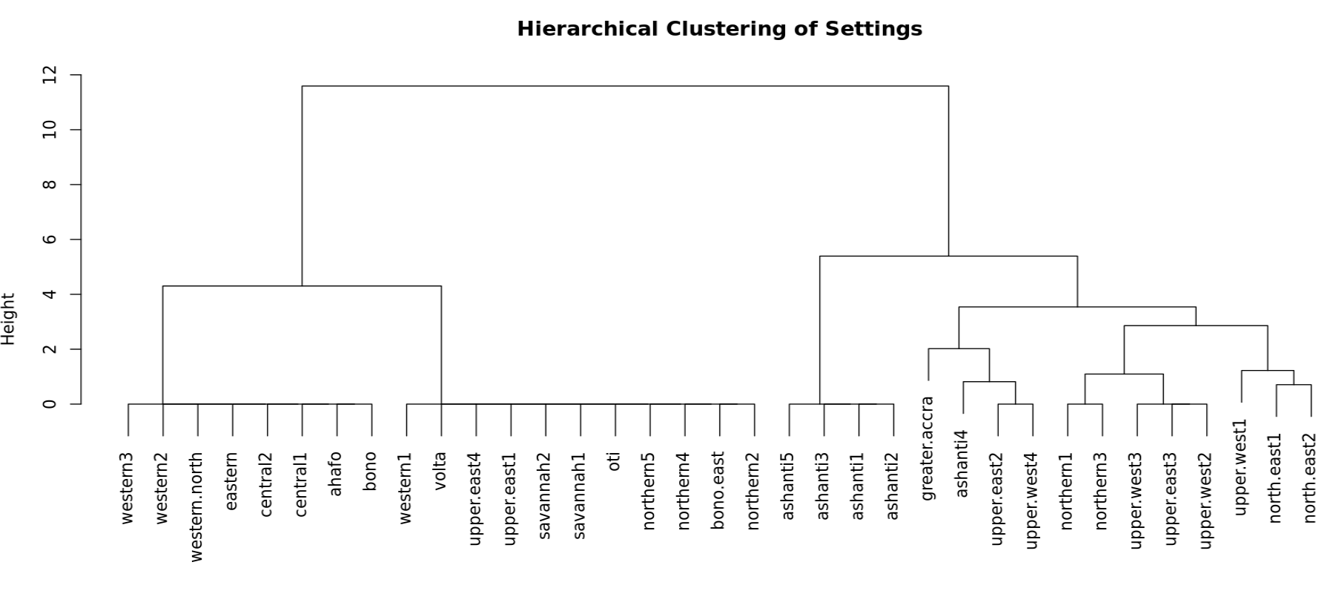
Sobol indices- Dendrogram
Notes:
LLINs is the most influential in determining the output variance

Slide 22
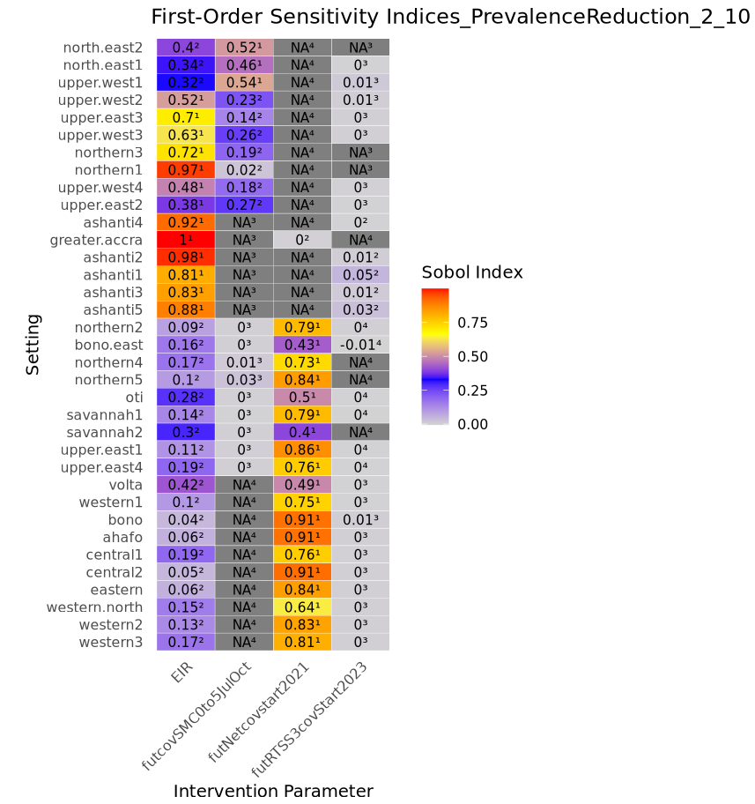
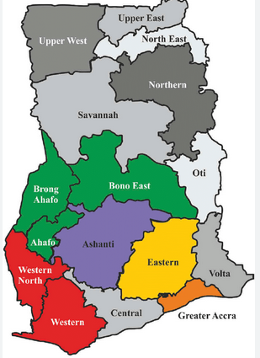
Sobol indices – hierarchical clustering of settings
Source: Andoh et al.
Notes:
LLINs is the most influential in determining the output variance

